Slide 1
Zebrafish Fukutin family proteins link the unfolded protein response with dystroglycanopathies
Article Review
Presented by Janet Minton
12/7/2011

Slide 2
Background and Scope
Congenital muscular dystrophies (CMD) are a heterogeneous group of hereditary autosomal recessive disorders caused by allelic variants of gene defects; more commonly result in mild forms known as limb girdle muscular dystrophies (LGMD).
More severe allelic variants like CMD-1 are associated with deficiency in laminin α2 isoform cause early onset of progressive muscle degeneration, brain and eye structural abnormalities, and embryonic lethality in some cases
General pathogenesis of muscular dystrophies
Structural overview of dystrophin associated glyprotein complex (DGC): dystroglycan heterodimer
Laminin protein family functions
Glycosyltransferase genes: fukutin (FKTN) and fukutin related protein (FKRP)
Unfolded protein response (UPR)

Slide 3
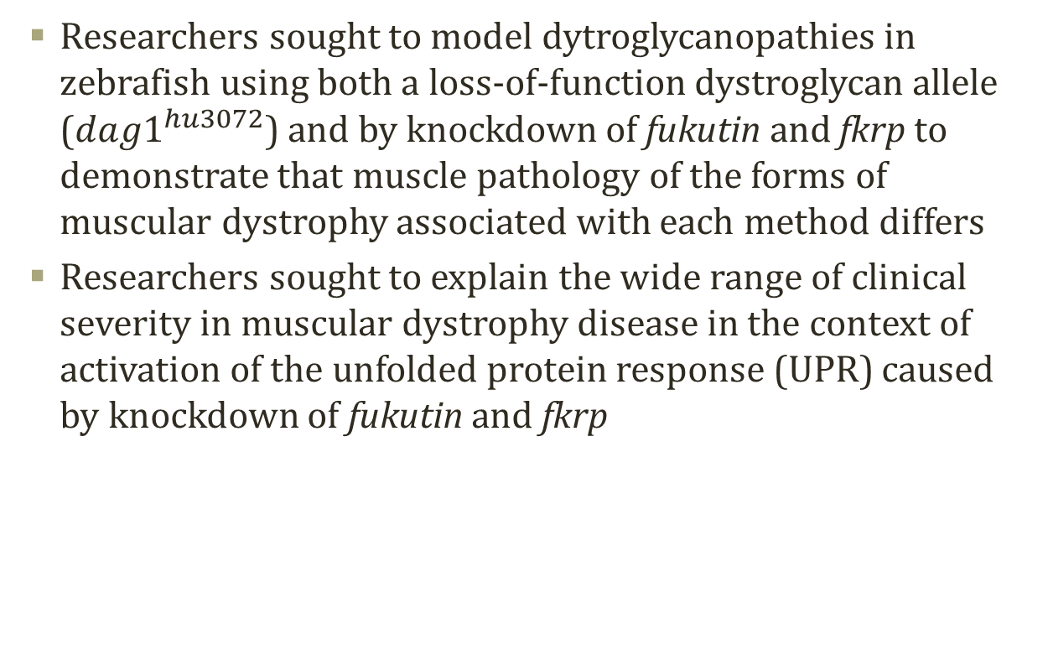
Objectives
Researchers sought to model dytroglycanopathies in zebrafish using both a loss-of-function dystroglycan allele (${dag1}^{hu3072}$) and by knockdown of fukutin and fkrp to demonstrate that muscle pathology of the forms of muscular dystrophy associated with each method differs
Researchers sought to explain the wide range of clinical severity in muscular dystrophy disease in the context of activation of the unfolded protein response (UPR) caused by knockdown of fukutin and fkrp

Slide 4
Loss of dystroglycan disrupts dystrophin but not laminin localization

Slide 5
Muscle pathology in Fukutin or FKRP morpholino oligonucleotide-injected embryos is distinct from dystroglycan mutants

Slide 6
Knockdown of zebrafish Fukutin or FKRP leads to notochord defects prior to muscle degeneration

Slide 7
Laminin immunoreactivity is severely reduced in the posterior myoseptum of fkrp MO-injected embryos

Slide 8
Knockdown of Fukutin or FKRP perturbs the expression of laminin mRNA

Slide 9
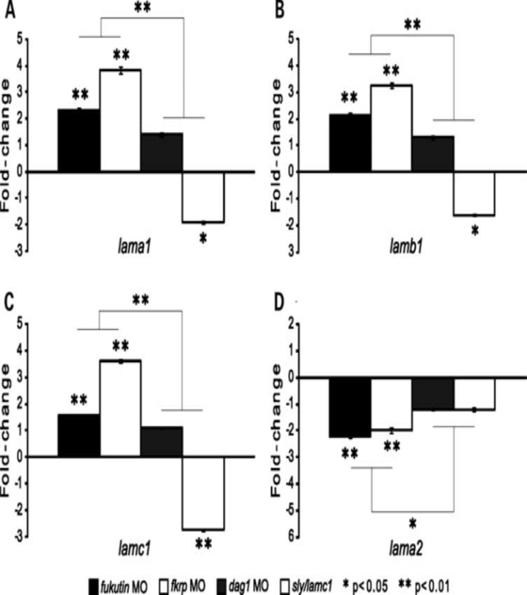
Expression of laminin α2 is selectively down-regulated in fukutin or fkrp MO-injected embryos

Slide 10
Knockdown of Fukutin or FKRP may affect protein secretion beyond glycosylation of α-dystroglycan

Slide 11
Knockdown of Fukutin or FKRP causes ER stress and activates the UPR

Slide 12
Discussion
Absence of dystroglycan is associated with detachment of muscle fibers and dislocation of dystrophin
Fukutin and fkrp MO-injected embryos develop muscular dystrophy with reduced dystrophin but no change in laminin localization, dystrophin immunoreactivity or muscle detachment; appears to involve a mechanism other than disruption of dystroglycan-ligand interactions
Fukutin and fkrp deficient embryos exhibit changes in laminin expression; aberrant expression of these genes may cause dysfunctional laminin polymerization in the basal membrane. Disorganized laminar structure in the brain and retina have been associated with severe forms of CMD.
Dystroglycanopathies resulting from knockdown of fukutin and fkrp appear to cause acute ER stress and UPR activation leading to translational repression, changes in transcription, ER-associated degradation (ERAD) and even activation of cell death mechanisms
UPR may be responsible for wide range of clinical severity associated with dystroglycanopathies

Slide 13
Future Research
Molecular modeling and biochemical studies to confirm glycosyltransferase activity of fukutin and fkrp would be of interest
Activation of UPR in human patients should be further studied; was not a universal finding in muscle biopsies taken from human patients with characterized dystroglycanopathies
Further studies on the roles of fukutin and fkrp in the secretory pathway

Slide 14
Critique
Some of the assays were not specifically re-visited or explored further by the authors in the discussion, for example, the concentration-dependent repression of fkrp enhanced green fluorescent protein in fkrp MO-injected embryos
At times it felt like the researchers were “putting the cart before the horse,” as when they drew conclusions about the role of fukutin and fkrp knockdown in hypoglycosylation of α-dystroglycan and in disruption of the protein secretory pathway while simultaneously noting that neither glycosyltransferase enzymatic activities nor specific roles in the secretory pathway of either fukutin or fkrp had been confirmed

Slide 15
Q&A

